Slide 1

Chapter 3
Consumer Preferences and the Concept of Utility

Slide 2

Chapter Three Overview
1. Motivation
2. Consumer Preferences and the Concept of Utility
3. The Utility Function
Marginal Utility and Diminishing Marginal Utility
4. Indifference Curves
5. The Marginal Rate of Substitution
Some Special Functional Forms
Chapter Three

Slide 3
Motivation
• Why study consumer choice?
Study of how consumers with limited resources choose goods and services
Helps derive the demand curve for any good or service
Businesses care about consumer demand curves
Government can use this to determine how to help and whom to help buy certain goods and services
Chapter Three

Slide 4
Consumer Preferences
Consumer Preferences tell us how the consumer would rank (that is, compare the desirability of) any two combinations or allotments of goods, assuming these allotments were available to the consumer at no cost.
These allotments of goods are referred to as baskets or bundles. These baskets are assumed to be available for consumption at a particular time, place and under particular physical circumstances.
Chapter Three

Slide 5
Consumer Preferences
Assumptions
Complete and Transitive
Preferences are complete if the consumer can rank any two baskets of goods (A preferred to B; B preferred to A; or indifferent between A and B)
Preferences are transitive if a consumer who prefers basket A to basket B, and basket B to basket C also prefers basket A to basket C
A ⎬ B; B ⎬ C = > A ⎬ C
Chapter Three

Slide 6
Consumer Preferences
Assumptions
Monotonic / Free Disposal
Preferences are monotonic if a basket with more of at least one good and no less of any good is preferred to the original basket.
Chapter Three

Slide 7
Types of Ranking
Example:
Students take an exam. After the exam, the students are ranked according to their performance. An ordinal ranking lists the students in order of their performance (i.e., Harry did best, Joe did second best, Betty did third best, and so on). A cardinal ranking gives the mark of the exam, based on an absolute marking standard (i.e., Harry got 80, Joe got 75, Betty got 74 and so on).
Chapter Three

Slide 8
The Utility Function
The three assumptions about preferences allow us to represent preferences with a utility function.
Utility function
– a function that measures the level of satisfaction a consumer receives from any basket of goods and services.
– assigns a number to each basket so that more preferred baskets get a higher number than less preferred baskets.
– U = U(y), for one good y, or U = U (x,y) for two goods x and y.
Chapter Three

Slide 9

The Utility Function
Implications:
An ordinal concept: the precise magnitude of the number that the function assigns has no significance.
Utility not comparable across individuals.
Any transformation of a utility function that preserves the original ranking of bundles is an equally good representation of preferences. e.g. U = vs. U = + 2 represent the same preferences. {Same for any positive power of , , i.e. y itself, y^{1.5} etc.}
Chapter Three
Notes:
Check that underlying preferences are complete, transitive, monotonic and averages are preferred to extremes.

Slide 10
Marginal Utility
Marginal Utility of a good y
additional utility that the consumer gets from consuming a little more of y
i.e. the rate at which total utility changes as the level of consumption of good y rises
MU_{y} = ΔU/Δy
slope of the utility function with respect to y
Chapter Three
Notes:
See Figure 3.2

Slide 11
Diminishing Marginal Utility
The principle of diminishing marginal utility states that the marginal utility falls as the consumer consumes more of a good.
Chapter Three
Notes:
See Figure 3.2

Slide 12
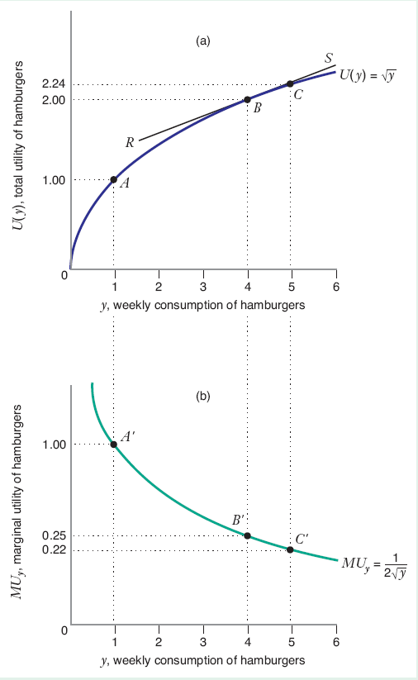
Diminishing Marginal Utility
Chapter Three
Notes:
See Figure 3.2

Slide 13
Marginal Utility
The marginal utility of a good, x, is the additional utility that the consumer gets from consuming a little more of x when the consumption of all the other goods in the consumer’s basket remain constant.
U(x, y) = x + y
ΔU/Δx (y held constant) = MU_{x} = 1
ΔU/Δy (x held constant) = MU_{y} = 1
Chapter Three

Slide 14
Marginal Utility
Example of U(H) and MU_{H}
U(H) = 10H – H²
MU_{H} = 10 – 2H
H | H² | U(H) | MU_{H}
2 | 4 | 16 | 6
4 | 16 | 24 | 2
6 | 36 | 24 | -2
8 | 64 | 16 | -6
10 | 100 | 0 | -10
Chapter Three

Slide 15
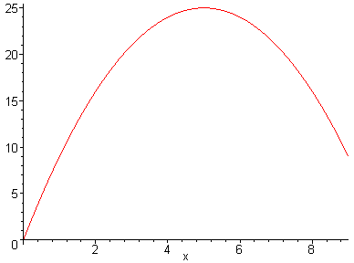
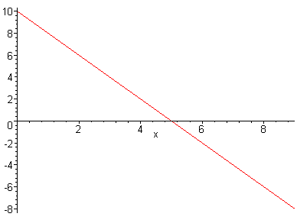
Marginal Utility
U(H) = 10H – H²
MU_{H} = 10 – 2H
Chapter Three

Slide 16
Marginal Utility
Example of U(H) and MU_{H}
The point at which he should stop consuming hotdogs is the point at which MU_{H} = 0
This gives H = 5.
That is the point where Total Utility is flat.
You can see that the utility is diminishing.
Chapter Three

Slide 17
Marginal Utility – multiple goods
U = xy²
MU_{x} = y²
MU_{y} = 2xy
More is better? More y more and more x indicates more U so yes it is monotonic
Diminishing marginal utility?
MU of x is not dependent of x. So the marginal utility of x (movies) does not decrease as the number of movies increases.
MU of y increases with increase in number of operas (y) so neither exhibits diminishing returns.
Chapter Three

Slide 18
Indifference Curves
An Indifference Curve or Indifference Set: is the set of all baskets for which the consumer is indifferent
An Indifference Map : Illustrates a set of indifference curves for a consumer
Chapter Three

Slide 19
Indifference Curves
Key Properties
1) Monotonicity => indifference curves have negative slope – and indifference curves are not “thick”
2) Transitivity => indifference curves do not cross
3) Completeness => each basket lies on only one indifference curve
Chapter Three

Slide 20
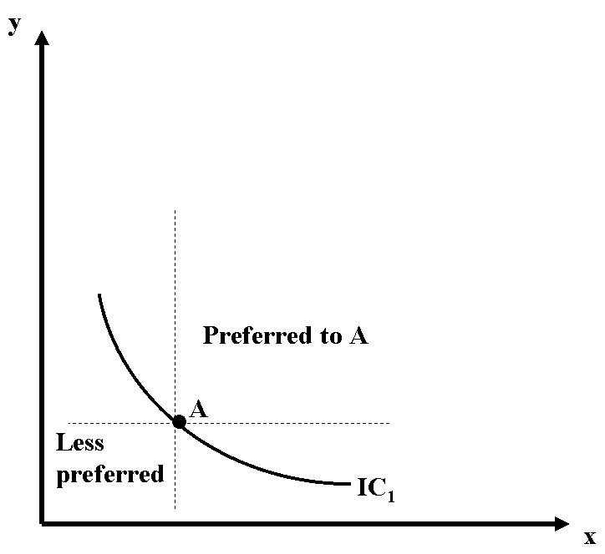
Indifference Curves
Monotonicity
Chapter Three

Slide 21
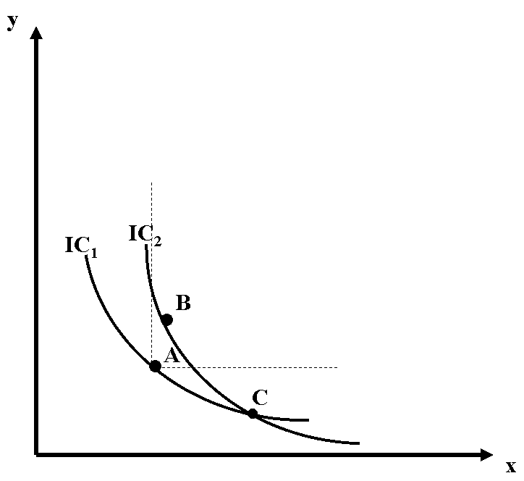
Indifference Curves
Cannot Cross
Suppose that B preferred to A.
but..by definition of IC,
B indifferent to C
A indifferent to C => B indifferent
to C by transitivity.
And thus a contradiction.
Chapter Three

Slide 22
Indifference Curves
Example
U = xy²
Check that underlying preferences are complete, transitive, and monotonic.
x | y | xy^2
8 | 4.24 | 143.8
4 | 6 | 144
3 | 6.93 | 144.07
1 | 12 | 144
Chapter Three
Notes:
We show later that the diminishing MRS implies averages are preferred to extremes for indifference curves.

Slide 23
Indifference Curves
Example: Utility and the single indifference curve.
Chapter Three

Slide 24
Marginal Rate of Substitution
The marginal rate of substitution: is the maximum rate at which the consumer would be willing to substitute a little more of good x for a little less of good y;
It is the increase in good x that the consumer would require in exchange for a small decrease in good y in order to leave the consumer just indifferent between consuming the old basket or the new basket;
It is the rate of exchange between goods x and y that does not affect the consumer’s welfare;
It is the negative of the slope of the indifference curve:
MRS_{x,y} =
-Δy/Δx
(for a constant level of preference)
Chapter Three

Slide 25
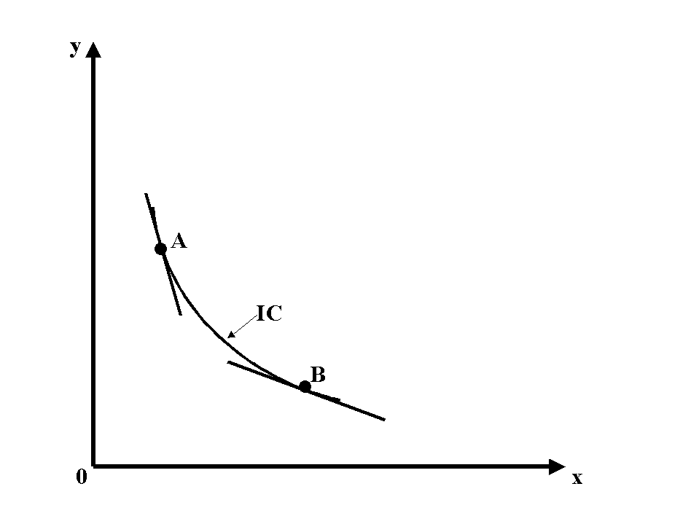
Marginal Rate of Substitution
The Diminishing Marginal
Rate of Substitution
If the more of good x you have, the more you are willing to give up to get a little of good y or the indifference curves get flatter as we move out along the horizontal axis and steeper as we move up along the vertical axis
Chapter Three

Slide 26
Marginal Rate of Substitution
MU_{x}(Δx) + MU_{y}(Δy) =
0 …along an IC…
MU_{x}/MU_{y} =
-Δy/Δx =
MRS_{x,y}
Positive marginal utility implies the indifference curve has a negative slope (implies monotonicity)
Diminishing marginal utility implies the indifference curves are convex to the origin (implies averages preferred to extremes)
Chapter Three

Slide 27
Marginal Rate of Substitution
The Marginal Rate of Substitution
Implications of this substitution:
Indifference curves are negatively-sloped, bowed out from the origin, preference direction is up and right
Indifference curves do not intersect the axes
(well, that’s all true for multiplicative utility like U = (xy)^{1/2})
Chapter Three

Slide 28
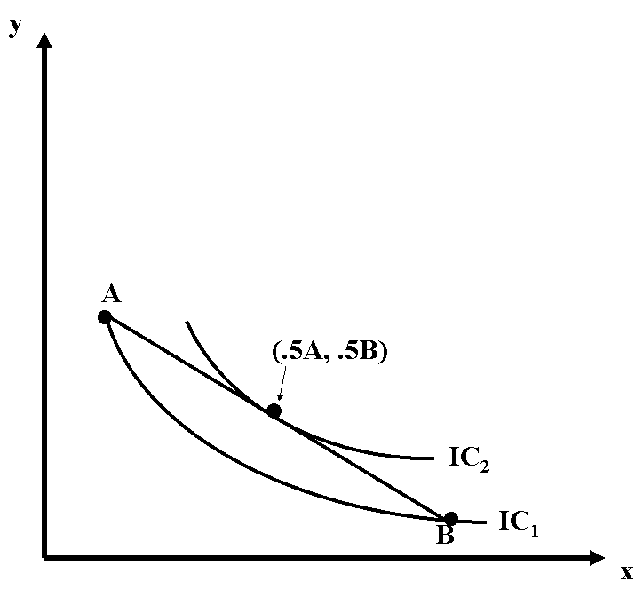
Indifference Curves
Key Property
Averages preferred to extremes => indifference curves are bowed toward the origin (convex to the origin).
Chapter Three

Slide 29
Indifference Curves
Do the indifference curves intersect the axes?
A value of x = 0 or y = 0 is inconsistent with any positive level of utility.
Chapter Three

Slide 30
Marginal Rate of Substitution
The Marginal Rate of Substitution
Example: U = Ax²+By²; MU_{x}=2Ax; MU_{y}=2By
(where: A and B positive)
MRS_{x,y}
= MU_{x}/MU_{y}
= 2Ax/2By
= Ax/By
Marginal utilities are positive (for positive x and y)
Marginal utility of x increases in x;
Marginal utility of y increases in y
Chapter Three

Slide 31
Indifference Curves
Example: U= (xy)^{.5};MU_{x}=y^{.5}/2x^{.5}; MU_{y}=x^{.5}/2y^{.5}
A. Is more better for both goods? Yes, since
marginal utilities are positive for both.
B. Are the marginal utility for x and y
diminishing? Yes. (For example, as x increases,
for y constant, MU_{x} falls.)
C. What is the marginal rate of substitution of x for y?
MRS_{x,y} = MU_{x}/MU_{y} = y/x
Chapter Three

Slide 32
Indifference Curves
y
Example: Graphing Indifference Curves
Preference direction
IC₂
IC₁
x
Chapter Three

Slide 33
Special Functional Forms
Cobb-Douglas: U = Ax^{α}y^{β}
where: α + β = 1; A, α,β positive constants
MU_{X} =
αAx^{α-1}y^{β}
MU_{Y} =
β Ax ^{α}y^{β-1}
MRSx,y =
(αy)/(βx)
“Standard” case
Chapter Three

Slide 34
Special Functional Forms
y
Example: Cobb-Douglas (speed vs. maneuverability)
Preference Direction
IC₂
IC₁
x
Chapter Three

Slide 35
Special Functional Forms
Perfect Substitutes: U = Ax + By
Where: A, B positive constants
MU_{x} = A
MU_{y} = B
MRS_{x,y} = A/B so that 1 unit of x is equal to
B/A units of y everywhere
(constant MRS).
Chapter Three

Slide 36
Special Functional Forms
y
Example: Perfect Substitutes
(Tylenol, Extra-Strength Tylenol)
Slope = -A/B
IC₁
IC₂
IC₃
0
x
Chapter Three

Slide 37
Special Functional Forms
Perfect Complements: U = A min(x,y)
where: A is a positive constant.
MU_{x} = 0 or A
MU_{y} = 0 or A
MRS_{x,y} is 0 or infinite or undefined (corner)
Chapter Three

Slide 38
Special Functional Forms
y
Example: Perfect Complements
(nuts and bolts)
IC₂
IC₁
0
x
Chapter Three

Slide 39
Special Functional Forms
Quasi-Linear Preferences:
U = v(x) + Ay
Where: A is a positive constant.
MU_{x} = v’(x) = ΔV(x)/Δx, where Δ small MU_{y} = A
"The only thing that determines your personal trade-off between x and y is how much x you already have."
*can be used to "add up" utilities across individuals*
Chapter Three

Slide 40
Special Functional Forms
y
Example: Quasi-linear Preferences
(consumption of beverages)
IC₂
IC₁
IC’s have same slopes on any
vertical line
•
•
0
x
Chapter Three

